Slide 1


BMS INSTITUE OF TECHNOLOGY
Full Stack Web-Development
Dr. Shiva kumara T
Assistant Professor
Prepared by Shashank Katti
1BY22MC047

Slide 2
Table Contents
Definition
Introduction
Classification
Frontend Roadmap
Backend Roadmap
Full-Stack Developer
What does Developer do?
Tools Used
Conclusion
2
Notes:
SAY: Before we wrap up the course, let’s review what we have learned today.
During this course, we have
<READ the bullets from the slide.>
GO to next slide.

Slide 3
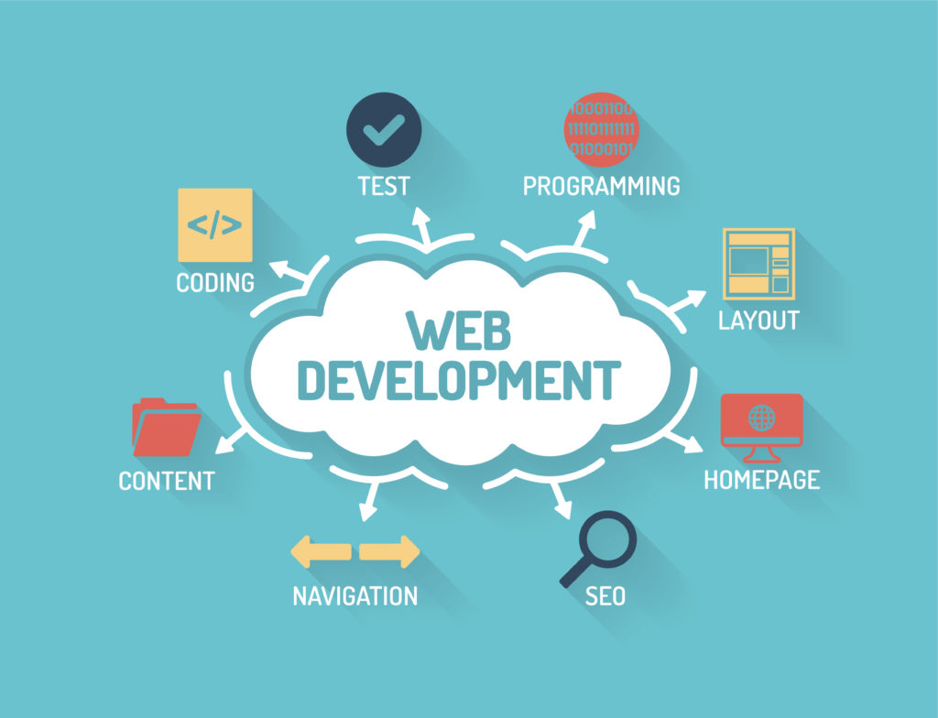
Definition
The word Web Development is made up of two words:
Web: It refers to websites, web pages or anything that works over the internet.
Development: Building the application from scratch.
3
Notes:
SAY: Before we wrap up the course, let’s review what we have learned today.
During this course, we have
<READ the bullets from the slide.>
GO to next slide.

Slide 4
Introduction
Web development refers to the building, creating, and maintaining of websites. It includes aspects such as web design, web publishing, web programming, and database management.
It is the creation of an application that works over the internet i.e. websites.
The term development is usually reserved for the actual construction of these things (that is to say, the programming of sites). The basic tools involved are programming languages called HTML (Hypertext Markup Language), CSS (Cascading Style Sheets), and JavaScript.
4
Notes:
SAY: Before we wrap up the course, let’s review what we have learned today.
During this course, we have
<READ the bullets from the slide.>
GO to next slide.

Slide 5
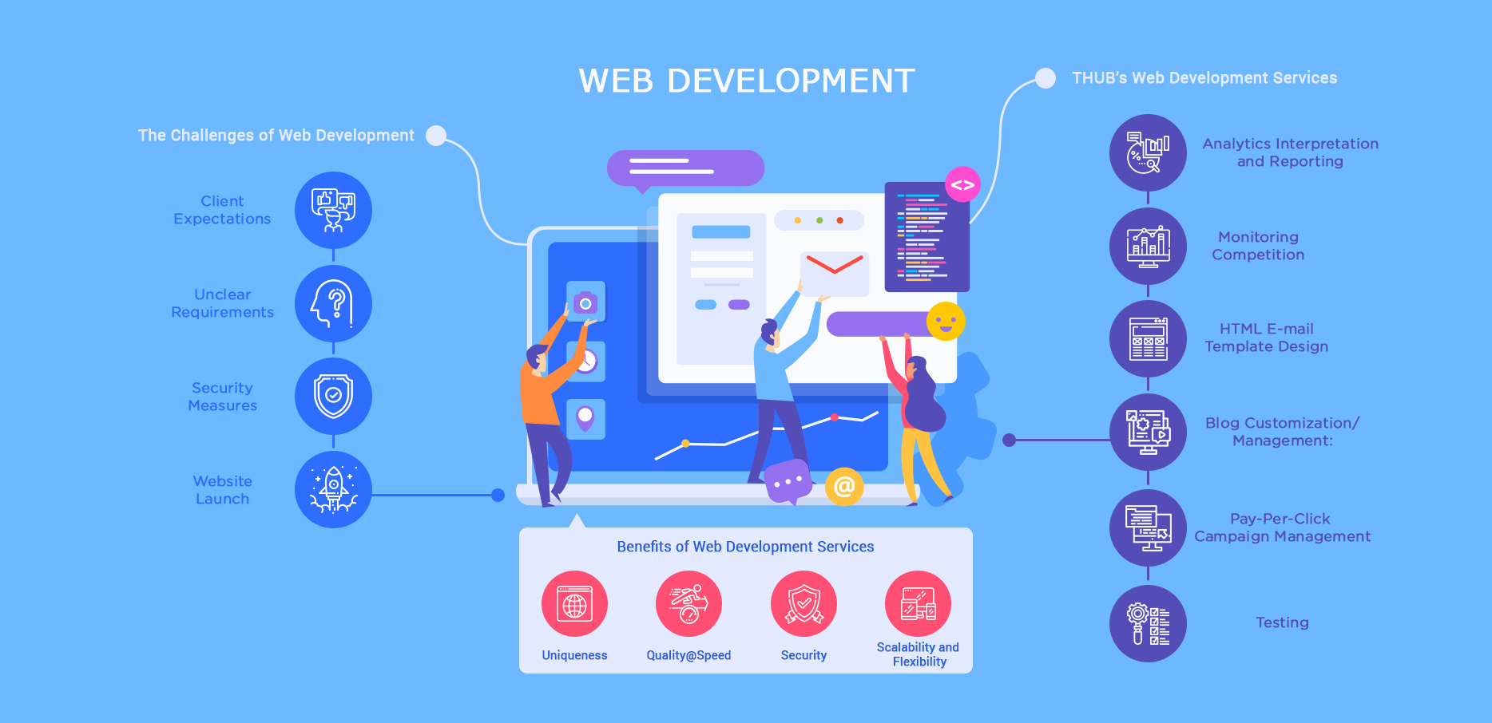
5
Notes:
SAY: Before we wrap up the course, let’s review what we have learned today.
During this course, we have
<READ the bullets from the slide.>
GO to next slide.

Slide 6
Classification
Web Development can be classified into two ways:
Frontend Development: The part of a website that the user interacts directly is termed as front end. It is also referred to as the ‘client side’ of the application.
Backend Development: Backend is the server side of a website. It is the part of the website that users cannot see and interact. It is the portion of software that does not come in direct contact with the users. It is used to store and arrange data.
6
Notes:
SAY: Before we wrap up the course, let’s review what we have learned today.
During this course, we have
<READ the bullets from the slide.>
GO to next slide.

Slide 7
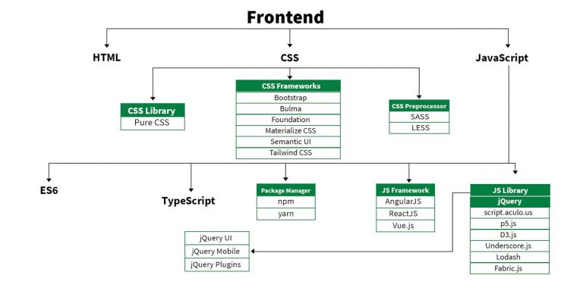
Frontend Roadmap
●●●
7
Notes:
SAY: Before we wrap up the course, let’s review what we have learned today.
During this course, we have
<READ the bullets from the slide.>
GO to next slide.

Slide 8
Frontend Roadmap
HTML: HTML stands for Hyper Text Markup Language. It is used to design the front end portion of web pages using markup language. It acts as a skeleton for a website since it is used to make the structure of a website.
CSS: Cascading Style Sheets fondly referred to as CSS is a simply designed language intended to simplify the process of making web pages presentable. It is used to style our website.
JavaScript: JavaScript is a scripting language used to provide a dynamic behavior to our website.
●●●
8
Notes:
SAY: Before we wrap up the course, let’s review what we have learned today.
During this course, we have
<READ the bullets from the slide.>
GO to next slide.

Slide 9
Frontend Roadmap
Bootstrap: Bootstrap is a free and open-source tool collection for creating responsive websites and web applications.
It is the most popular CSS framework for developing responsive, mobile-first websites. Nowadays, the websites are perfect for all the browsers (IE, Firefox, and Chrome) and for all sizes of screens (Desktop, Tablets and Phones).
Bootstrap 4
Bootstrap 5
Notes:
SAY: Before we wrap up the course, let’s review what we have learned today.
During this course, we have
<READ the bullets from the slide.>
GO to next slide.

Slide 10
Frontend Roadmap
Frontend Frameworks and Libraries:
HTML
CSS
JAVASCRIPT
REACT.JS
ANGULAR.JS
VUE.JS
10
Notes:
SAY: Before we wrap up the course, let’s review what we have learned today.
During this course, we have
<READ the bullets from the slide.>
GO to next slide.

Slide 11
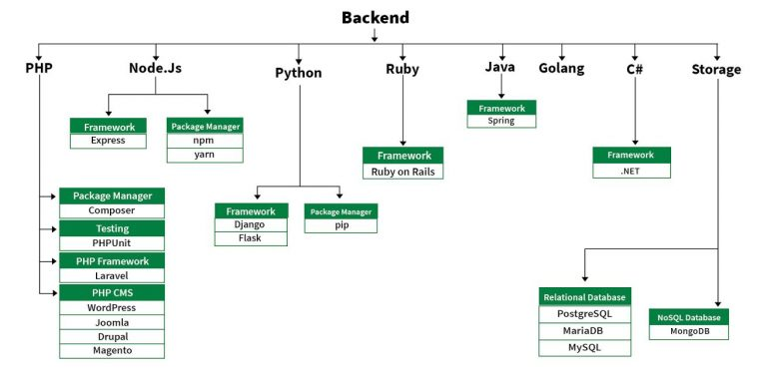
Backend Roadmap
●●●
11
Notes:
SAY:
The purpose of epidemiology in public health practice is to
discover the agent, host, and environmental factors that affect health;
determine the relative importance of causes of illness, disability, and death;
identify those segments of the population that have the greatest risk from specific causes of ill health; and
evaluate the effectiveness of health programs and services in improving population health.
GO to next slide.

Slide 12
Backend Roadmap
PHP: PHP is a server-side scripting language designed specifically for web development.
Java: Java is one of the most popular and widely used programming language. It is highly scalable.
Python: Python is a programming language that lets you work quickly and integrate systems more efficiently.
Node.js: Node.js is an open source and cross-platform runtime environment for executing JavaScript code outside a browser.
●●●
12
Notes:
SAY:
The purpose of epidemiology in public health practice is to
discover the agent, host, and environmental factors that affect health;
determine the relative importance of causes of illness, disability, and death;
identify those segments of the population that have the greatest risk from specific causes of ill health; and
evaluate the effectiveness of health programs and services in improving population health.
GO to next slide.

Slide 13
Web Development
Frontend Languages & Markup:
HTML: Standard markup language for creating web pages.
CSS: Style sheet language for describing the presentation of web pages.
JavaScript: Scripting language for creating dynamic content.

Slide 14
Frameworks & Libraries:
React: A JavaScript library for building user interfaces.
Angular: A TypeScript-based open-source web application framework.
Vue.js: A progressive JavaScript framework for building user interfaces.
Svelte: A new approach to building user interfaces where the bulk of the work happens at compile time.
Bootstrap: A CSS framework for developing responsive and mobile-first websites.
Tailwind CSS: A utility-first CSS framework for rapidly building custom designs

Slide 15
BUILD TOOLS & MODULE BUNDLERS
Webpack: A module bundler for JavaScript applications.
Parcel: A zero-configuration build tool.
Rollup: A module bundler for JavaScript, primarily used for library bundling.
BACKEND LANGUAGES
JavaScript (Node.js): Server-side JavaScript environment.
Python: Widely used for server-side applications (e.g., Django, Flask).
Ruby: Known for Ruby on Rails framework.
PHP: Widely used for server-side scripting.
Java: Often used for enterprise-level applications (e.g., Spring framework).
Go: Known for its performance and efficiency in backend development.
C#: Used in ASP.NET for backend development.

Slide 16
Frameworks
Express.js: A minimal and flexible Node.js web application framework.
Django: A high-level Python web framework.
Flask: A microframework for Python.
Ruby on Rails: A server-side web application framework written in Ruby.
Spring Boot: A Java-based framework for creating standalone applications.
ASP.NET Core: A cross-platform, high-performance framework for building modern, cloud-based, and internet-connected applications.
Mobile Development Languages
Java: Traditionally used for Android development.
Kotlin: Modern language for Android development.
Swift: Language for iOS development.
Objective-C: Older language for iOS development.
Dart: Language used with the Flutter framework.

Slide 17
Frameworks:
React Native: Allows building mobile apps using React.
Flutter: Google's UI toolkit for building natively compiled applications for mobile, web, and desktop from a single codebase.
Ionic: A framework for building cross-platform mobile apps using web technologies.
Xamarin: A Microsoft-owned framework for building native Android, iOS, and Windows apps using C#.
Cordova/PhoneGap: Enables building mobile apps using HTML, CSS, and JavaScript.

Slide 18
IoT Development Languages
C: Widely used for programming microcontrollers.
C++: Used for more complex IoT applications.
Python: Increasingly popular in IoT for its simplicity and extensive libraries.
JavaScript (Node.js): Used in IoT for its non-blocking I/O model.
Java: Used in IoT due to its portability and security features.
Rust: Gaining popularity for IoT due to its safety and performance.
Frameworks & Platforms:
Arduino: A platform for building electronics projects.
Raspberry Pi: A small, affordable computer for learning programming and hardware projects.
ESP8266/ESP32: Wi-Fi-enabled microcontrollers used for IoT projects.
Platform-IO: An open-source ecosystem for IoT development.
Google Cloud IoT: Provides managed services to securely connect, manage, and ingest data from globally dispersed devices.
Amazon AWS IoT: A managed cloud platform that lets connected devices easily and securely interact with cloud applications and other devices.

Slide 19
Backend Roadmap
Back End Frameworks
The list of back end frameworks are:
Express,
Django,
Rails,
Spring,
MySql, etc.
19
Notes:
SAY:
The purpose of epidemiology in public health practice is to
discover the agent, host, and environmental factors that affect health;
determine the relative importance of causes of illness, disability, and death;
identify those segments of the population that have the greatest risk from specific causes of ill health; and
evaluate the effectiveness of health programs and services in improving population health.
GO to next slide.

Slide 20
General Tools and Technologies
Version Control:
Git: Distributed version control system.
GitHub: Platform for hosting and collaborating on Git repositories.
GitLab: Similar to GitHub with additional CI/CD features.
Bitbucket: Another Git repository hosting service.
Package Managers:
Npm: Node package manager for JavaScript.
Yarn: A package manager that doubles down as project manager.
pip: Python package installer.
gem: Ruby package manager.
Maven: Dependency management for Java.
Gradle: Build automation tool for Java and Android.

Slide 21
HOW RESPONSE ARE MADE FROM BACKEND TO FRONTEND
Request-response communication between the backend and the frontend is a fundamental part of web application architecture. This process involves multiple steps and components working together to enable dynamic interaction between a client (frontend) and a server (backend). Here's an explanation of how it works:
1. User Action on the Frontend
The process begins with an action taken by the user on the frontend, such as clicking a button, submitting a form, or navigating to a new page. For example, a user clicks a "Submit" button on a web form.
2. Sending a Request to the Backend
When the user performs an action, the frontend (typically written in HTML, CSS, and JavaScript) sends an HTTP request to the backend server. This request can be sent using various methods, such as:
AJAX (Asynchronous JavaScript and XML): Using the XML Http Request object or fetch API in JavaScript.
Form Submission: Using an HTML form with the method attribute set to POST or GET.

Slide 22
3. Processing the Request on the Backend
The backend server receives the HTTP request. The backend is typically implemented using server-side technologies like Node.js, Python (Django, Flask), Ruby (Rails), Java (Spring), etc.
The server processes the request, which may involve querying a database, performing calculations, or other business logic.
The backend then prepares a response, often in the form of JSON data.
4. Sending the Response Back to the Frontend
The backend server sends the prepared response back to the frontend as an HTTP response. This response contains a status code (e.g., 200 OK, 404 Not Found) and the data (often in JSON format).
5. Handling the Response on the Frontend
The frontend receives the HTTP response. JavaScript handles the response, updating the user interface dynamically based on the received data.

Slide 23
Summary
User Action: The user interacts with the frontend.
HTTP Request: The frontend sends an HTTP request to the backend.
Backend Processing: The backend processes the request and prepares a response.
HTTP Response: The backend sends the response back to the frontend.
Response Handling: The frontend handles the response and updates the UI accordingly.

Slide 24
Full-Stack Developer
A Full-Stack Developer is someone familiar with both front- and back-end development. They are generalists, adept at wearing both hats, and familiar with every layer of development. Obviously, employers want to hire Full-Stack Developers – according to an Indeed study, they are the fourth-most in-demand job in tech.
If the title is contentious, it’s in the generalist nature of the position. Developers who specialize in the front-end or back-end often bristle at the notion that someone could be equally adept at both – the expression “jack-of-all-trades, master of none” comes to mind.
24
Notes:
SAY:
The purpose of epidemiology in public health practice is to
discover the agent, host, and environmental factors that affect health;
determine the relative importance of causes of illness, disability, and death;
identify those segments of the population that have the greatest risk from specific causes of ill health; and
evaluate the effectiveness of health programs and services in improving population health.
GO to next slide.

Slide 25
What Does Web-Developer Do?
Translating wireframe designs into working code
Creating the architecture and content of a site
Building in functionality and Responsivity
Making a site go live
Updating and renovating sites
Troubleshooting, fixing bugs, and glitches
25
Notes:
SAY:
The purpose of epidemiology in public health practice is to
discover the agent, host, and environmental factors that affect health;
determine the relative importance of causes of illness, disability, and death;
identify those segments of the population that have the greatest risk from specific causes of ill health; and
evaluate the effectiveness of health programs and services in improving population health.
GO to next slide.

Slide 26
Conclusion
In today's Web development, a good page design is essential. A bad design will lead to the loss of visitors and that can lead to a loss of business. In general, a good page layout has to satisfy the basic elements of a good page design.
This includes color contrast, text organization, font selection, style of a page, page size, graphics used, and consistency. In order to create a well-designed page for a specific audience.
26
Notes:
SAY:
The purpose of epidemiology in public health practice is to
discover the agent, host, and environmental factors that affect health;
determine the relative importance of causes of illness, disability, and death;
identify those segments of the population that have the greatest risk from specific causes of ill health; and
evaluate the effectiveness of health programs and services in improving population health.
GO to next slide.

Slide 27
References
"Learning Full Stack Development: From Front-End to Back-End with JavaScript“ Author: John Smith Publisher: Tech Publications, 2019
"The Complete Guide to Full Stack Development“ Author: Jane Doe Journal: Journal of Software Engineering, 2020
"Full Stack Development with MEAN and MERN“ Author: Michael Brown Publisher: Code Master Press, 2021

Slide 28
Thank You

